Slide 1
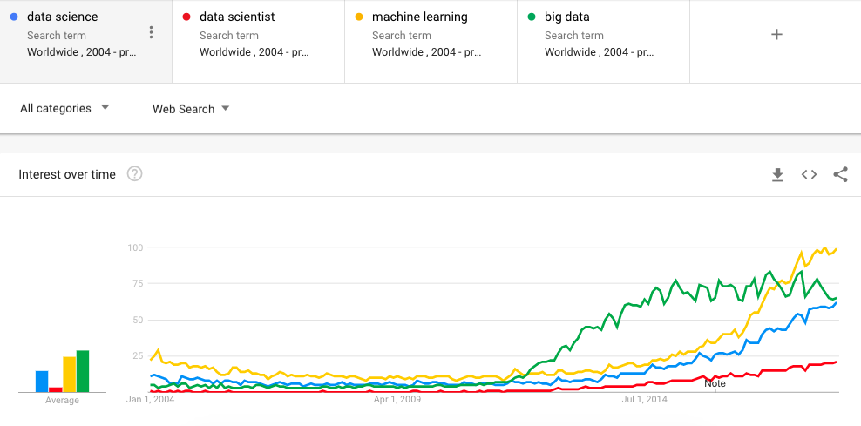
Welcome to Data 602
Ben Payne
These notes are CC BY 4.0
If it were a real license, I'd use http://matt.might.net/articles/crapl/
Notes:
https://trends.google.com/trends/

Slide 2
Ground Rules, Expectations

Slide 3
Outcomes for this evening
By the end of today's class, you should be able to answer the following:
What are the perks and dangers of employment in the government
Describe at least 5 ways to check data for meaningfulness
Prioritize activities relevant to a data scientist

Slide 4
At the end of class, I'm going to ask you for feedback:
What did you learn
What was not clear?

Slide 5
{ Costs | Benefits | Risks } of Data Science
Count off by 1,2,3,4,5,1,2,3,4,5,1,2,3,4,5
Form groups by your number
Write down
3 costs of data science
3 benefits of data science
3 risks in data science

Slide 6
Warnock's dilemma adapted for lecture
When I get no response from y'all, there are a couple hypotheses:
The information is correct, well-delivered that needs no follow-up commentary. There's nothing more to say except "Yeah, got it."
The information is complete and utter nonsense, and no one wants to waste the energy to even point this out.
No one heard/saw the information, for whatever reason.
No one understood the information, but won't ask for clarification, for whatever reason.
No one cares about the information, for whatever reason.

Slide 7

About me
About me
Software in Data Science
Activity: Negotiation with data owners
Sanity checks
Activity: ordering of activities
Automation

Slide 8

Life before now: 7 years in Air National Guard as F-16 Crew Chief
http://datascience.umbc.edu/faculty.php

Slide 9
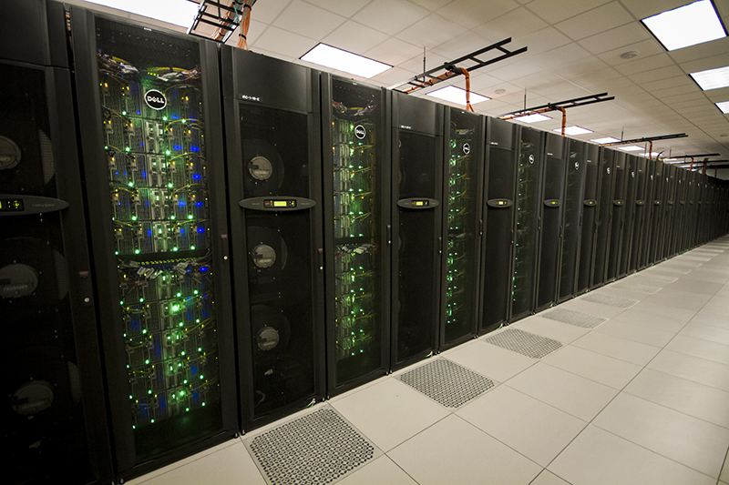
Life before now: PhD in Physics
http://datascience.umbc.edu/faculty.php

Slide 10
How to Science
Observation
= Data
Test
= (in)validate assumptions
Curiosity about relations
Model = a story using math
to describe relations
in the data
Prediction
= based on assumptions
Notes:
https://www.youtube.com/watch?v=j12BBcKSgEQ

Slide 11
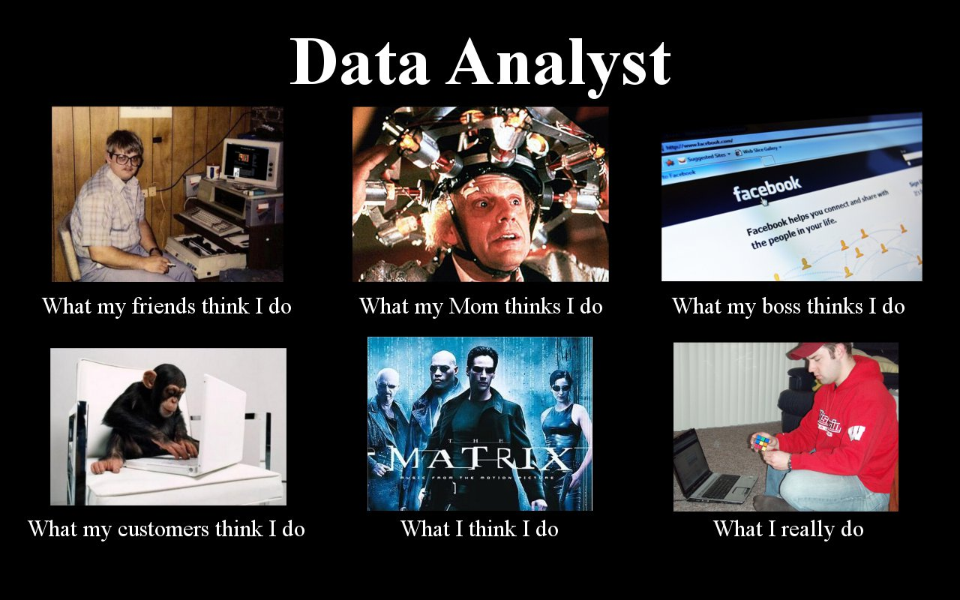

Slide 12
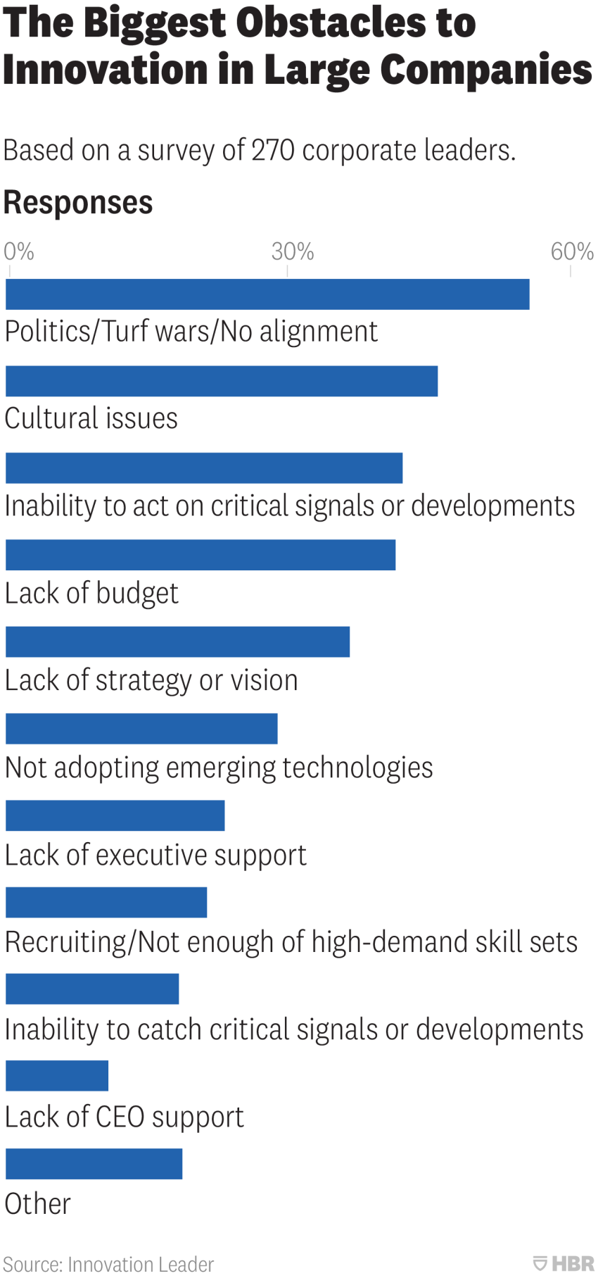
You're in a graduate-level Data Science class. When you leave here, employers and customers will expect you to have skills.
My experience is that the technical skills (math, programming, domain expertise) are a small component of being a successful data scientist.
Effective data science requires communication skills and sensitivity to non-technical aspects
Data 601 is "Introduction to Data Science", so it needs to address issues beyond math and programming.
https://hbr.org/2018/07/the-biggest-obstacles-to-innovation-in-large-companies

Slide 13
Relevance of Machine Learning to Business
https://www.wired.com/story/joi-ito-ai-and-bus-routes/
https://news.ycombinator.com/item?id=18432079

Slide 14
Relevance of folklore in Data Science
Observation
= Data
Test
= (in)validate assumptions
Curiosity about relations
Model = a story using math
to describe relations
in the data
Prediction
= based on assumptions

Slide 15
What does a data scientist do all day?
I have autonomy because my employer expects I know what I'm doing
Work from 9 to 5 M-F, or 10 to 4, or whatever suits my needs
Read and write emails
Go to meetings; run meetings
Have impromptu discussions with stakeholders
Write documentation, read papers
Write code
Manage data
No day repeats
No day is predictable
https://www.kdnuggets.com/2017/11/day-life-data-scientist.html
Notes:
https://www.kdnuggets.com/2017/11/day-life-data-scientist.html

Slide 16
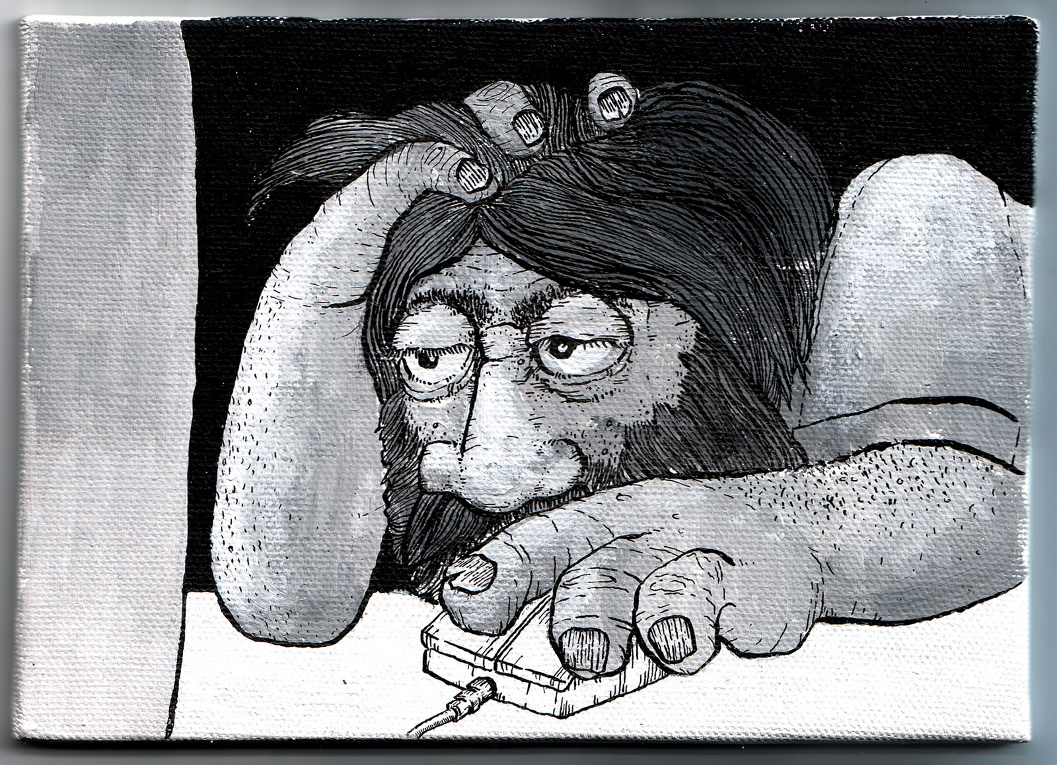

Slide 17


Emotions in Data Science
As a data scientist, most of your time will be spent in a desert of uncertainty, frustration, and doubt.
There will be rare short-lived interspersed spikes of excitement and happiness due to events like getting a new dataset, creating a new analytic, getting a new result, or being thanked by a stakeholder.
This experience is normal and does not go away.
See also the psychology of slot machines
Notes:
https://www.vhtcx.com/wp-content/uploads/2015/02/canstockphoto3986275.jpg
https://www.vhtcx.com/blog/5-causes-customer-frustration-fix/

Slide 18
Working in government
40 hours per week enables work/life balance
24 hours of flex time
5 weeks paid vacation
Health insurance
Job security/stability
Ability to change roles

Slide 19
Working in government
40 hours per week enables work/life balance
24 hours of flex time
5 weeks paid vacation
Health insurance
Job security/stability
Ability to change roles
Significant bureaucratic momentum in large organization
Limited authority
Other employees may not be motivated
Low tolerance for risk
Many policies and legal constraints

Slide 20
Application of Science benefits Decision makers
Alternatives include
Random Guesses
Guesses based on past experience
Inaccurate use of methods which may not be applicable
http://www.au.af.mil/au/awc/awcgate/army-usawc/strat_d-m_paradigms2010.pdf

Slide 21
Data Science doesn't always win
Having a correct and complete solution does not mean it gets selected
Decision makers can be swayed
By emotionally-driven stories
On the basis of prior relationships
To select a cheaper option.
It is vital to determine what convinces your audience before investing effort in Data Science analysis that uses code, data, math.
If your customer plays the lottery, they may not understand your numerical results

Slide 22
Make a claim, Test the claim
A claim should be falsifiable. The test should be statistically meaningful.
In practice, strictness depends on intended outcome.
Good enough to make money:
Altering what color the button on your ecommerce website is to maximize sales
Recommending a movie to viewers
Critical to safety or health of humans:
Determining which dosage of a drug is efficacious for medical treatments
Guidance for an autonomous vehicle

Slide 23
Knowledge gain through Data Science is an investment
Experiments incur risk
"failure" means learning, but also means no product is generated
Limited budget for investment means less data.
The scale of your data limits the scope of your claim.

Slide 24
Small challenges with not much data
As a business employee or bureaucrat or politician
How do I improve decision making processes?
How do I evaluate the outcome of decisions?
How do I decrease the risk when faced with an opportunity?
How do I convince other stakeholders of the best course of action?
While not taking too much time, spending too much money, using the resources I already have access to, and in a way that is convincing?

Slide 25
Even with limited investment, Science is still useful
The limited budget means shortcuts are tempting

Slide 26
Hard task in Science: Reproducibility
Someone else, following only your documentation, should be able to get an outcome that validates your claim.
An investment without immediate benefit.
Who's impacted by reproducibility: your future self; others.
Notes:
https://en.wikipedia.org/wiki/Reproducibility
https://en.wikipedia.org/wiki/Replication_crisis

Slide 27
Example reasons why reproducibility fails
The outcome was specific to the data used
Assumptions were wrong
Software implementation has a bug
Documentation provided is insufficient to enable reproducibility
Notes:
https://en.wikipedia.org/wiki/Reproducibility
https://en.wikipedia.org/wiki/Replication_crisis

Slide 28
Survey: What is your background?

Slide 29
Survey: what do you plan to do with data science?

Slide 30
Software in Data Science
About me
Software in Data Science
Activity: Negotiation with data owners
Sanity checks
Activity: ordering of activities
Automation

Slide 31
Design your approach to solving the problem
On a piece of paper, write down actions you'll need to take
Determine the dependencies among the actions you need to take
In what order should the steps be?
Then take the listed actions using your computer

Slide 32

Pro-tip: Offline Program Design
Getty images
I use bad meetings as the time to write out programs on paper
Assume clean data
Know the expected input, desired output, and relevant transforms
Notes:
https://www.inc.com/steve-tobak/6-ideas-for-awesome-meetings.html

Slide 33
Survey of "standard" software for Data Science
(not comprehensive)
Hive
MapReduce
Pig
JavaScript
Java
Orange
Rapid Miner
SAS
Enterprise Miner
JMP
Online services, ie from Azure, AWS, Google Compute
Matlab
Python
R
Tensor Flow
Jupyter
Julia
Spark
SQL
Excel
PowerBI and other plugins
Tableau

Slide 34

Psychological consequences of diversity
Intimidation (fear) due to knowing you don't know

Slide 35
Psychological consequences of diversity
Intimidation (fear) due to knowing you don't know
When interacting with other people, lack of overlap causes issues
Communication
How you think about the problem
What the challenges are (cost, latency, scale)
How to collaborate
--> Each of these is a negotiation with other humans

Slide 36

I Simplify by focusing on just Python
Since 1991
Python 3 is 10 years old!
Notes:
https://tinybuddha.com/blog/4-tiny-powerful-tips-reduce-stress-anxiety/

Slide 37
Survey of "standard" Python packages for Data Science
(not comprehensive)
Dask
Scikit-learn
Numpy
Scipy
Pandas
Matplotlib
Python Imaging Library (PIL)
NLTK
Beautifulsoup
Statsmodels
Seaborn
PyTorch
Keras
Theano
Gensim
Plotly
Bokeh
PySpark
Scrapy
Optional challenge: How many Python packages are there total?
Yes, this question is ill-defined. I'm happy to iterate with you after class

Slide 38
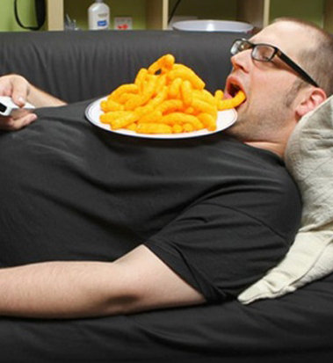
Virtues of a Data Scientist
Using libraries enables laziness.
see http://blog.teamtreehouse.com/the-programmers-virtues
Notes:
https://www.infoworld.com/article/3122803/application-development/the-power-of-lazy-programming.html

Slide 39
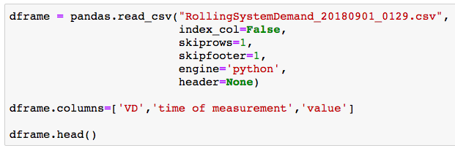
Complex commands do not just appear; I iteratively discover commands
I don't memorize these commands. I build them iteratively.
The final result is concise; it hides hours of detective work.

Slide 40
I use free software and free data
There's lots of commercial software available
Financially, I don't want to pay for software or data
Morally, I want to enable reproducibility for other people
Notes:
https://www.gnu.org/philosophy/shouldbefree.en.html

Slide 41
Data Science is more than Math and Software
Human interaction in data science
Discovering stakeholders
Negotiating with data owners
Customer engagement
https://hbr.org/2017/01/the-best-data-scientists-get-out-and-talk-to-people

Slide 42
Iterating with customers
As a data scientist, you'll often be working for someone other than yourself.
Expect under-specified requirements from customers. Iterate.
Provide incomplete solutions rather than waiting until the product is perfect.
https://en.wikipedia.org/wiki/Minimum_viable_product

Slide 43

Customer didn't think it was possible, so they didn't bother asking
Notes:
https://kramers.com/story-time

Slide 44
Consequences of Exploration
Exploration means you don't know.
Not all your investments get to the customer
You will write code you discard
Perfection is a wasted on exploration
In contrast, product development focuses on what will reach customers in order to minimize costs.

Slide 45
Activity: Negotiation with data owners
About me
Software in Data Science
Activity: Negotiation with data owners
Sanity checks
Activity: ordering of activities
Automation

Slide 46
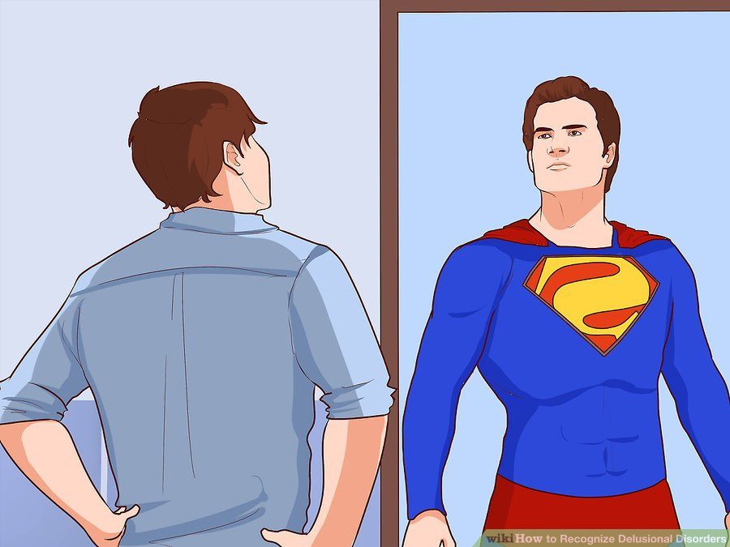
Knowing math, programming, and
data science theory helps in interviews
and getting hired.
Being conversant means you can
learn more about relevant topics.
Technical skills are distinct from skills in negotiation, identifying root causes of organizational issues, and interacting with stakeholders.
Your success as a data scientist depends on both soft and tech skills.
Notes:
https://www.wikihow.com/Recognize-Delusional-Disorders

Slide 47
Working with data owners
Not all data is directly accessible
As a data scientist in a large organization, your team isn't the profit generator
The data scientist also isn't the knowledge owner
You have to convince people with data that you can help them
You have to convey ability to assist and ability to communicate at their level in their jargon

Slide 48
Role play activity: negotiating to find fear/hope
Part 1
Data owners move to one side of room,
data requesters move to other side
Review your prompts
Each group collaborates on strategy

Slide 49
Role play activity: negotiating to find fear/hope
Part 2
Find a partner from the other team that you haven't collaborated with recently
Engage your partner

Slide 50
(Activity) Negotiation with partner
Requester asks Owner, "do you have this data set?"
Owner says, "Yes"
Requester: "I want a copy of the data you have."
Owner: use an excuse
Requester: persist
Owner: indicate fear
Requester: how will you address the owner's fear?

Slide 51
Sanity checks
About me
Software in Data Science
Activity: Negotiation with data owners
Sanity checks
Activity: ordering of activities
Automation

Slide 52

Cleaning data is an investment
Before cleaning data, make sure outcome is relevant to your customers
Fake data can be useful
to help enumerate requirements and expectations

Slide 53

CSV quiz

Slide 54

ID, last name, first name, tuition
058582, Potter, Jr, Harry, $204
0485572, Weasley, Ron, $958
592424, Granger, Hermione, $422
472492, Diggory, Cedric, $1,042
493824, Weasley, Fred, $394
Q: What is wrong with this CSV?
Activity: raise your hand if you have an answer
Notes:
https://support.clever.com/hc/en-us/articles/218518698-How-do-I-troubleshoot-CSV-formatting-errors-
image
https://bensbargains.com/thecheckout/awesomeness/25-hilarious-images-will-definitely-trigger-nerd-rage/

Slide 55
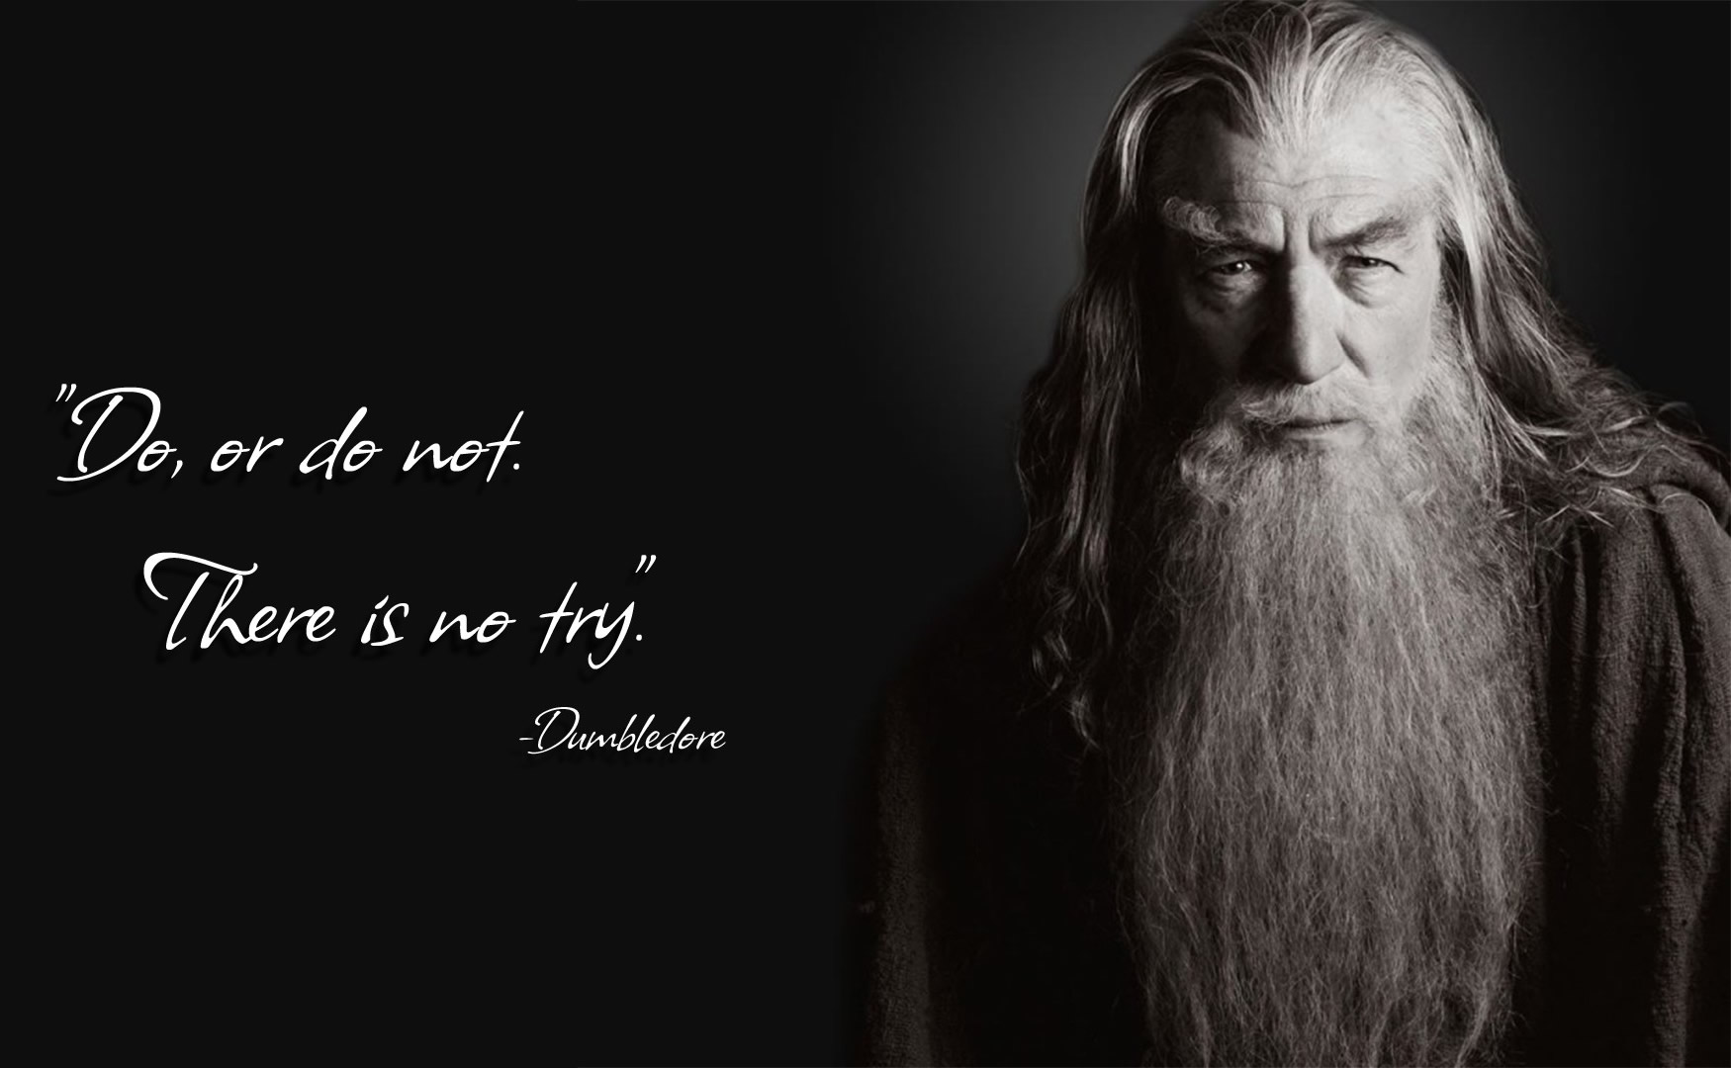
ID, last name, first name, tuition
058582, "Potter, Jr", Harry, $204
0485572, Weasley, Ron, $958
592424, Granger, Hermione, $422
472492, Diggory, Cedric, "$1,042"
493824, Weasley, Fred, $394
Q: What is wrong with this CSV?
A: Two mistakes with unquoted commas
Notes:
https://support.clever.com/hc/en-us/articles/218518698-How-do-I-troubleshoot-CSV-formatting-errors-
image
https://bensbargains.com/thecheckout/awesomeness/25-hilarious-images-will-definitely-trigger-nerd-rage/

Slide 56

"Unreasonable" Parsing
header separated by commas
First data column separated by :
Subsequent columns separated by |
Notes:
https://www.unlv.edu/event/storytime-barrick-museum-1

Slide 57

Be Skeptical; Don't trust your data
Is author a source I can contact if I have questions or concerns?
Does data appear to be regularly updated and checked for errors?
Does data come with information as to how it was acquired and what types of samples were used in its acquisition?
Is there another source of data that can verify and validate this dataset?
Given my overall knowledge of the topic, does this data seem plausible?
Source: page 128 of "Data Wrangling with Python"

Slide 58
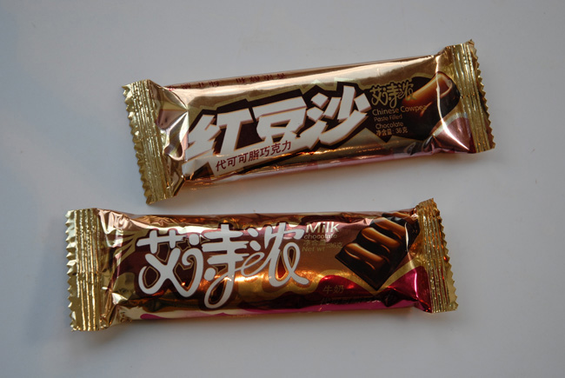

sanity checks for numerical variables
is the data self-consistent?
Sensical?
Is numerical variable within a bounded range?
Cost of candy bar is $132,402 USD
Cost of a sofa is $0.0042
For numerical variables, sort or find max and min

Slide 59
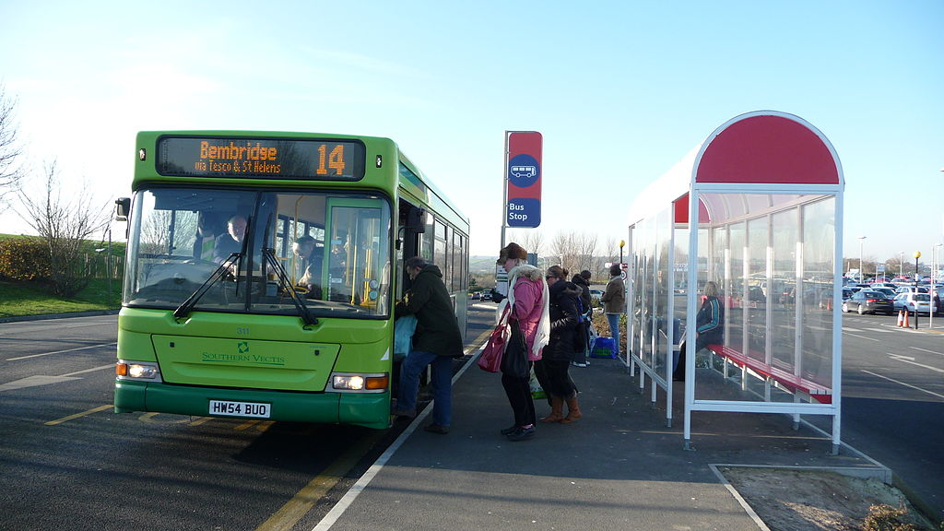
sanity checks for numerical variables
Variance too wide or not as wide as expected
15 of 28 bus arrival times between 3:09:12pm and 3:09:34pm
For numerical variables,
measure variance

Slide 60
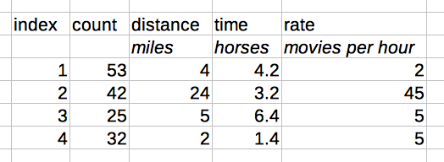
sanity checks for numerical variables
Check units of all columns to make sure they are meaningful

Slide 61
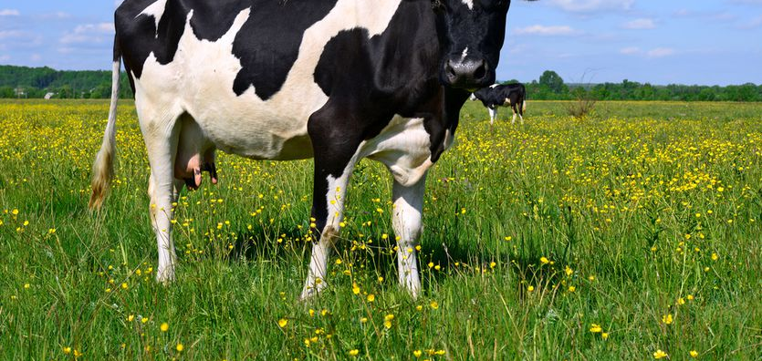
sanity checks for numerical variables
Are values non-sensical?
Negative values (i.e. a length)
Fractional values for counting (i.e., there are 4.28 cows)
Percentages of a whole that exceed 100% (i.e., 153% of the chapters in a book)
For numerical variables, sort or find max and min

Slide 62
sanity checks for numerical variables
Are values unusual?
Ages of 100 people, but only ages are 10,20,30,40
For numerical variables,
a histogram would show this if bin count is appropriate

Slide 63
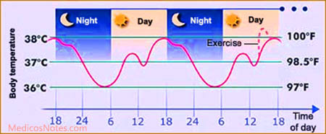
sanity checks for numerical variables
Values that oscillate (usually temporal variation)
https://en.wikipedia.org/wiki/Diurnal_temperature_variation
https://en.wikipedia.org/wiki/Diurnal_cycle
http://notes.medicosnotes.com/2016/05/normal-body-temperature-and-its.html

Slide 64
Example sanity checks for text
Street Address: 59@4 Thomas Street
Name: Alice, Be#$, Kate
Name: Buck, Robert, 4' cable, Cindy
Categorical: Yes/No/Cats
Lists elements
List of names: ['Bob', 'Mary', 524]
List of colors: ['Blue', 'Red', 'Orange', 'Fruit']
List of states: ['Missouri', 'Wisconsin', 'Mexico']
List sizes: len(list_of_days_in_week) indicates 9
Data that claims to be XML, but is actually JSON
Data that claims to be text and is actually binary or otherwise encoded

Slide 65

Review of sanity checks
Is numerical variable within a bounded range?
Variance too wide or not as wide as expected
Check units of all columns to make sure they are meaningful
Are values non-sensical?
Are values unusual?
Values that oscillate (usually temporal variation)
Text anomalies

Slide 66
Check-in activity
Find a partner you haven't talked with previously (or at least recently)
Talk:
Explain to your partner two things you learned (or confirmed) during this class

Slide 67
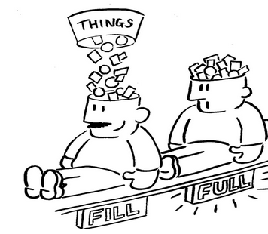
All done
Notes:
http://myemail.constantcontact.com/Is-your-brain-full-.html?soid=1105866149032&aid=fKlm9pjEiwk

Slide 68

Notes:
https://sayingimages.com/just-kidding-meme/

Slide 69
How to be a successful data scientist
Have multiple projects active at all times (though not too many)
Be able to split attention
Enables cross pollination of ideas
If something fails/is waiting/terminates, you can switch to something else
Don't spread yourself too thinly
Deliver results early and often
Constant dialog and feedback
Be able to explain value to organization

Slide 70
How to verify file consistency: check sums
https://en.wikipedia.org/wiki/MD5#MD5_hashes
https://en.wikipedia.org/wiki/Checksum
import hashlib
def md5(fname):
hash_md5 = hashlib.md5()
with open(fname, "rb") as f:
return hash_md5.hexdigest()
md5(filename)

Slide 71
Activity: ordering of activities
About me
Software in Data Science
Activity: Negotiation with data owners
Sanity checks
Activity: ordering of activities
Automation

Slide 72
Activity: ordering of activities
Count off by 5 (1, 2, 3, 4, 5, 1, 2, 3, 4, 5, 1, 2, 3, …)
Remember what number you are
Form a group of other people who have the same number
Each group of gets one set of "activities" that are part of your job as a data scientist
As a group, sort the activities into a prioritized list

Slide 73
Activity: ordering of activities
Count off by 5 (1, 2, 3, 4, 5, 1, 2, 3, 4, 5, 1, 2, 3, …)
Remember what number you are
Form a group of other people who have the same number
Each group of gets a set of "activities" that are part of your job as a data scientist
As a group, sort the activities into a prioritized list
As a group, describe to the class the first 6 activities you selected
Are there any activities than can be done concurrently?

Slide 74
Activity: ordering of activities
As a data scientist,
You will need to prioritize activities
You will need to negotiate priorities with other data scientists
You will need to justify your prioritization to stakeholders
Count off by 5 (1, 2, 3, 4, 5, 1, 2, 3, 4, 5, 1, 2, 3, …)
Remember what number you are
Form a group of other people who have the same number
Each group of gets a set of "activities" that are part of your job as a data scientist
As a group, sort the activities into a prioritized list
As a group, describe to the class the first 6 activities you selected
Are there any activities than can be done concurrently?

Slide 75
Automation
About me
Software in Data Science
Activity: Negotiation with data owners
Sanity checks
Activity: ordering of activities
Automation

Slide 76
How to figure out what to automate?
What's repetitive?
What's taking a long time?
Record what you're doing, then analyze logs
https://en.wikipedia.org/wiki/Quantified_self

Slide 77
Ways to exchange data with stakeholders
Verbal (in person, meetings, phone calls, video chat)
Email (ad hoc or scheduled), text messages
Presentations, i.e. Powerpoint
Data, i.e. Excel, in a directory
Analytics, i.e. programs written in Python (i.e. in Jupyter Notebooks)
Written documents , i.e. PDFs, DOCX (may also contain images and tables)
Web pages (may be interactive)

Slide 78
Ways to exchange data with stakeholders
If you only know how to manually use each of these channels, scalability of your impact is limited
Verbal (in person, meetings, phone calls, video chat)
Email (ad hoc or scheduled), text messages
Presentations, i.e. Powerpoint
Data, i.e. Excel
Analytics, i.e. programs written in Python (i.e. in Jupyter Notebooks)
Written documents , i.e. PDFs, DOCX (may also contain images and tables)
Web pages (may be interactive)

Slide 79
Send email from Python
http://127.0.0.1:8888/tree/send_email

Slide 80
Send text messages via email
Use SMS gateway domain
Depends on service provider

Slide 81

One thing you learned, One aspect that was not clear
Notes:
https://www.uptoparents.org/blog/wp-content/uploads/2017/09/iStock-652179644.jpg

Slide 82
Uncategorized

Slide 83
Buzzwords as indicators
The Cloud
Machine Learning
Artificial Intelligence
Big Data
Predictive Modeling
Labeled Data
EDA
ETL
Training models
Deep Neural Network
Moonshot
Structured data
Ben's claim: these words are not used by normal people

Slide 84
Question the speaker
What do you mean by that phrase?
Is the definition shared by speaker and audience?
What is an example of that?
What is the speaker's depth of experience?
What is the speaker's expectation of the audience?
What depth is expected for audience?

Slide 85
Lesson: Simply trusting data leads to invalid conclusion
Consistently question your data and your own analysis
Investigate how data was collected, by whom, for what purpose
Additional data often helps. Can relevant data be gathered?

Slide 86
More data ≠ More better
Given a sufficient number of random columns of numerical data,
a correlation will appear
Is there a reason to expect that two variables are correlated?
Competing hypotheses need to include
the Null hypothesis = no correlation exists for two observations
Notes:
https://stats.stackexchange.com/questions/5750/look-and-you-shall-find-a-correlation/5754
https://xkcd.com/882/

Slide 87
How to improve quicker: record your mistakes
Observe the mistake
What were the circumstances of the mistake?
Date
Time of day
Sleepiness
Hunger
Emotional state
What mechanisms will you implement or what behavior will you change to prevent future mistakes?
Occasionally review your mistake log

